Slide 1
Applicant Briefing
FEMA-4622-DR-NH & FEMA-4624-DR-NH

Slide 2
Purpose of Applicant Briefing
Overview of the Public Assistance (PA) Program
Describe the PA process
Answer general eligibility questions
Specific eligibility questions must be answered by FEMA during project development
Reference Material

Slide 3
Agenda
Major Disaster Declaration Granted
Explanation of Public Assistance (PA) Program
Eligibility
How To Apply
Project Considerations
Applicant Next Steps
Q & A

Slide 4
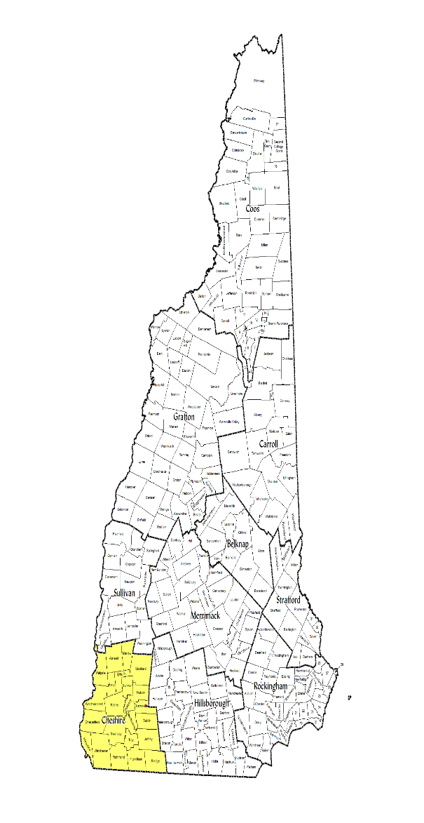
FEMA-4622-DR-NH
July 17-19, 2021 Severe Storm & Flooding
Declaration Date: September 30, 2021
Incident Period: July 17-19, 2021
Public Assistance Designated Counties:
Cheshire
Hazard Mitigation Grant Program
Statewide

Slide 5
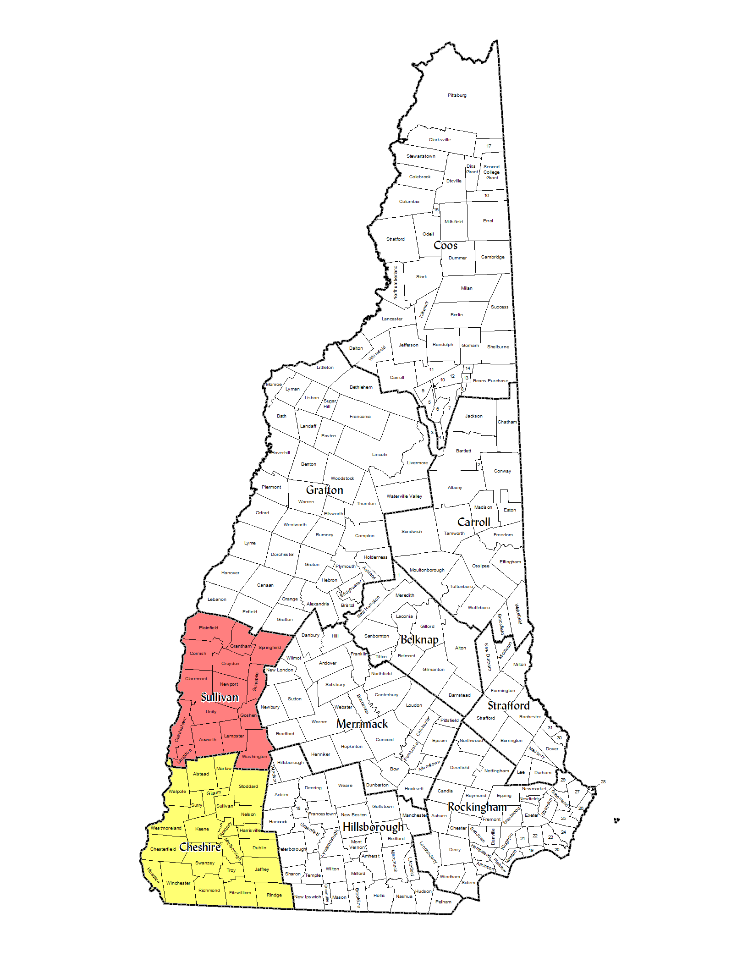
FEMA-4624-DR-NH
July 29-30, 2021 Severe Storm & Flooding
Declaration Date: October 4, 2021
Incident Period: July 29-30*, 2021
Public Assistance Designated Counties:
Cheshire
Sullivan
Hazard Mitigation Grant Program
Statewide
Notes:
At this time FEMA has denied Aug 1-2 as part of this disaster. However we will be appealing that. So at this time, only damages that were incurred July 29-30 are eligible.

Slide 6
Public Assistance Grant Program
Assists in the restoration of community infrastructure.
Supplemental funding program with specific eligibility requirements.
FEMA share of eligible costs will be awarded to the Recipient (HSEM) for disbursement to the Subrecipient (you).
75/25 cost-share
Authorities, Statutes & Regulations
Stafford Act
2 CFR
44 CFR
PAPPG
Notes:
FEMA provides assistance based on authorities defined in statutes and regulations. These authorities also specify requirements that must be met.
The statute that authorizes FEMA to provide assistance via the PA Program is the Robert T. Stafford Disaster Relief and Emergency Assistance Act, as Amended (Stafford Act)

Slide 7
Definitions
PA – Public Assistance
Recipient – State of NH
Applicant – entity applying for grant or subgrant
Subrecipient – once a grant is awarded, the Applicant becomes the Subrecipient
PAPPG – Public Assistance Program and Policy Guide
PNP – Private Non-Profit
PDMG – Program Delivery Manager
CFR – Code of Federal Regulations

Slide 8
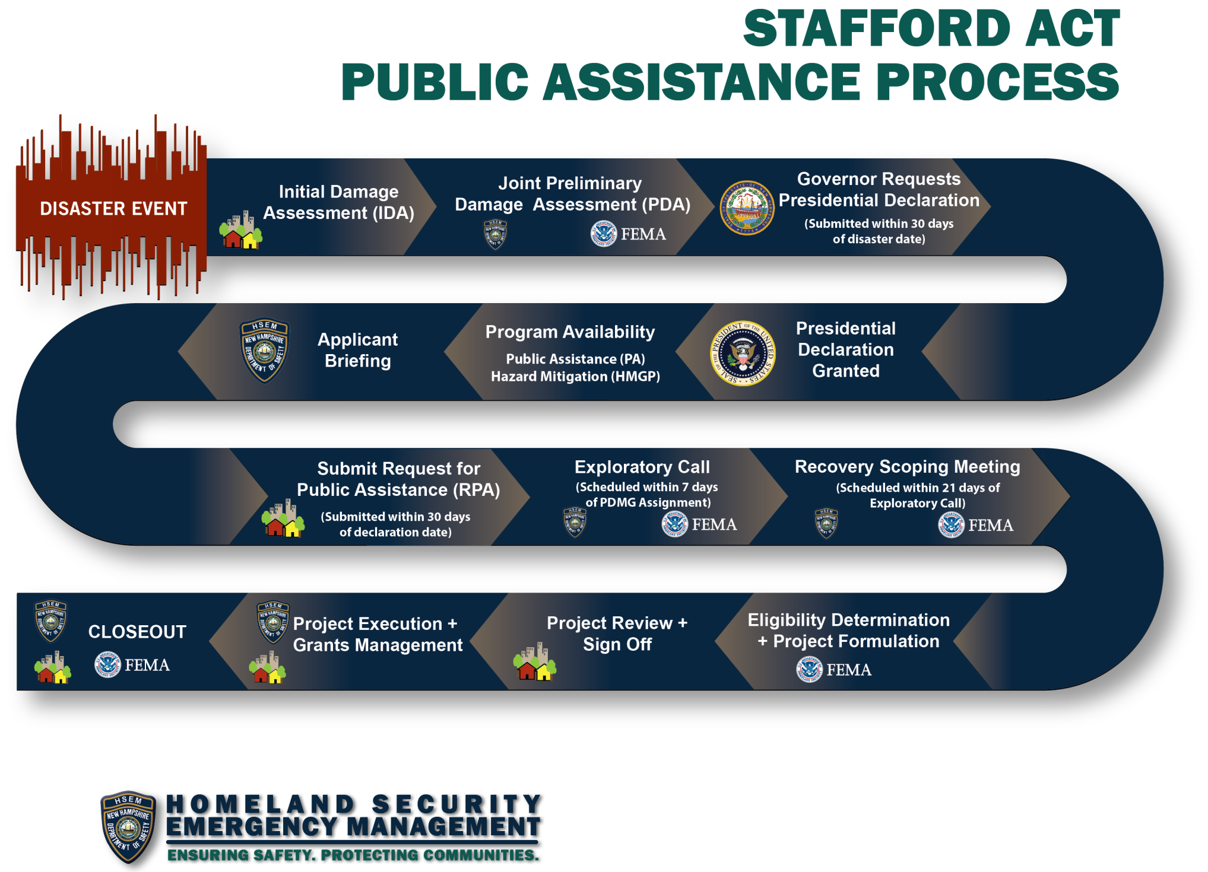
Today →

Slide 9
Public Assistance Eligibility
Cost
Work
Facility
Applicant
Notes:
There are four (4) eligibility requirements that must be met to participate in the PA Program.
The Subrecipient (Applicant) – is the basis for eligibility. The Subrecipient must be eligible for the facility to be eligible. The facility must be eligible for the work to be eligible. The work must be eligible for the cost to be eligible.

Slide 10
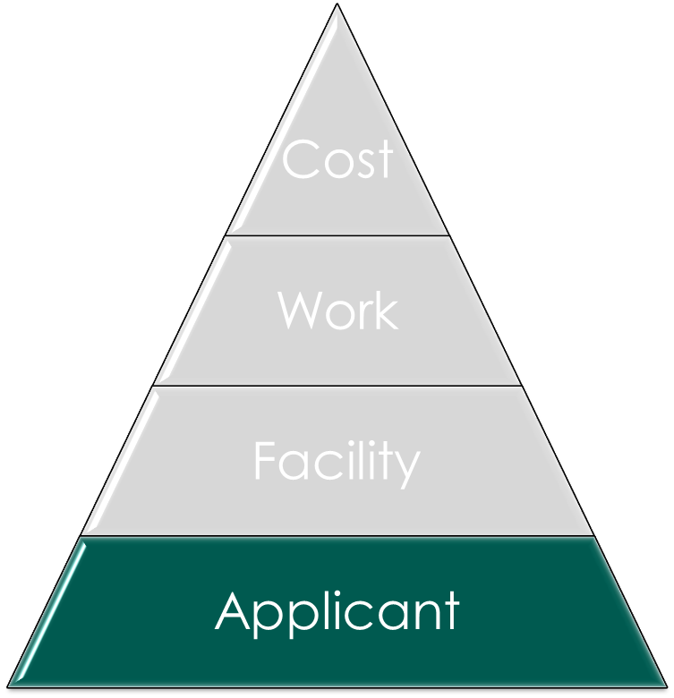
Applicants
State Government Agencies
Local governments and special districts
Including county level administrative offices, law enforcement, etc.
Private Nonprofit organizations (PNPs)
Provide critical or essential services
Federally recognized Native American Indian Tribes (none in NH)
Notes:
If an entity meets the requirements one (1) of the types, the Applicant may be eligible to receive Federal disaster assistance.

Slide 11
Private Nonprofits (PNP)
To be eligible for PA funding, a PNP must meet the following requirements:
Provide critical or essential government-type services
Be a tax-exempt nonprofit
Non-critical PNP’s must provide services to the general public
Critical Services – provide essential services to a community’s viability
Non-Critical, Essential Services – provide other essential governmental-type services to the community.
Notes:
PNP Facility MUST be the responsibility of an eligible PNP applicant and MUST provide an essential governmental service.
Services may range from but not limited to: Educational, Medical, Utilities, Museums, Homeless Shelters, Health and Safety Services.
Critical PNPs include: Fire/Emergency, Emergency Medical Care, Utilities, Communications, Educational Institutions
Non-Critical PNPs include: Sr. Citizen Day Centers, Daycare Centers, Homeless Shelters, Libraries, Rehabilitation Facilities, Community Centers.

Slide 12
PNP – Critical Services
Own or operate facilities that provide the following critical services are eligible for emergency and permanent work:
Education
Utility
Medical
Emergency Services (Fire, Ambulance, Rescue)
Notes:
PNP Facility MUST be the responsibility of an eligible PNP applicant and MUST provide an essential governmental service.
Services may range from but not limited to: Educational, Medical, Utilities, Museums, Homeless Shelters, Health and Safety Services.
Critical PNPs include: Fire/Emergency, Emergency Medical Care, Utilities, Communications, Educational Institutions
Non-Critical PNPs include: Sr. Citizen Day Centers, Daycare Centers, Homeless Shelters, Libraries, Rehabilitation Facilities, Community Centers.

Slide 13
PNP – Non-Critical, Essential Services
Essential service facilities are eligible for emergency work.
The PNP must apply to the Small Business Administration (SBA) for a disaster loan for permanent repair work. If the PNP is denied a SBA loan, FEMA may fund the repairs for:
Assisted Living Facilities
Community Centers
Houses of Worship
Libraries
Homeless Shelters
Food Assistance Programs
Rehabilitation Facilities
Senior Citizen/Childcare Centers
And other facilities that provide health and safety services of a governmental nature and are open to the general public
Notes:
PNP Facility MUST be the responsibility of an eligible PNP applicant and MUST provide an essential governmental service.
Services may range from but not limited to: Educational, Medical, Utilities, Museums, Homeless Shelters, Health and Safety Services.
Critical PNPs include: Fire/Emergency, Emergency Medical Care, Utilities, Communications, Educational Institutions
Non-Critical PNPs include: Sr. Citizen Day Centers, Daycare Centers, Homeless Shelters, Libraries, Rehabilitation Facilities, Community Centers.

Slide 14
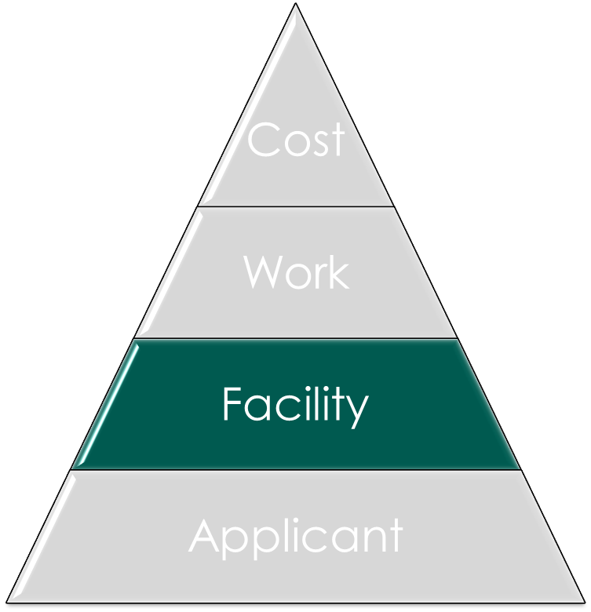
Facility Eligibility
To be eligible, the facility must be:
The legal responsibility of an eligible Applicant
In active use at the time of the disaster
Damaged as a result of the declared disaster
Located within the designated disaster area
Notes:
Facilities are not just 4 walled buildings – could be roads, parks, etc.

Slide 15
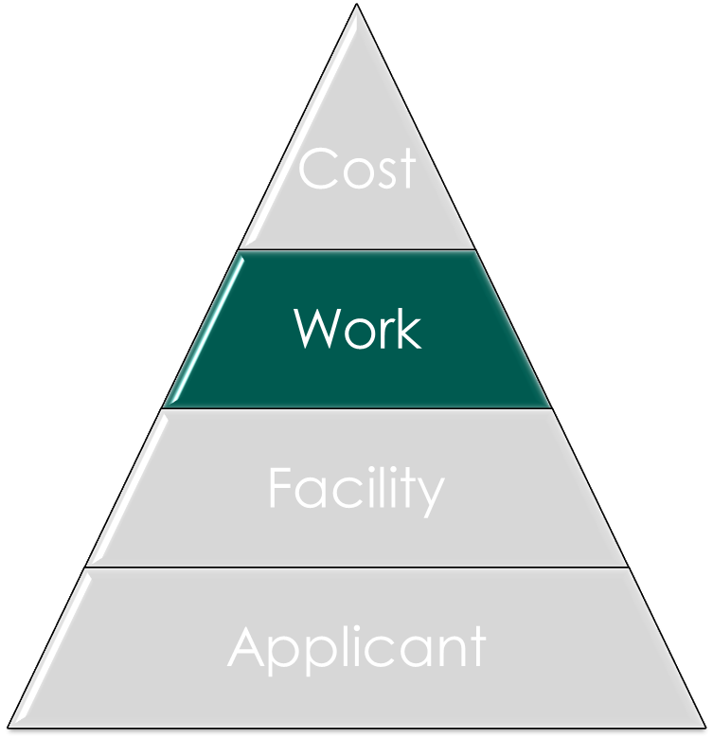
Work Eligibility
At a minimum, work must meet each of the following general criteria to be eligible:
Be required as the result of the declared incident
Be located within a designated disaster area
Be the legal responsibility of an eligible Applicant
Notes:
FEMA does not provide PA funding for repair of damage caused by:
• Deterioration;
• Deferred maintenance;
• The Applicant’s failure to take measures to protect a facility from further damage; or
• Negligence.

Slide 16
Work Eligibility
FEMA does not provide PA funding for repair of damage caused by:
• Deterioration;
• Deferred maintenance;
• The Applicant’s failure to take measures to protect a facility from further damage; or
• Negligence.
Notes:
FEMA does not provide PA funding for repair of damage caused by:
• Deterioration;
• Deferred maintenance;
• The Applicant’s failure to take measures to protect a facility from further damage; or
• Negligence.

Slide 17
Work Categories
A
Debris Removal
E
Buildings & Equipment
B
Emergency Protective Measures
C
Roads & Bridges
D
Water Control Facilities
G
Parks, Recreation & Other
F
Utilities
Emergency Work:
Address an immediate
threat
Permanent Work:
Restoration of Eligible Facilities under Categories C-G
Notes:
Eligible Work is broken into categories.
Cat. A (Debris Removal) & Cat. B (Emergency Protective Measures) are both considered Emergency Work.
Cat. C – G are considered Permanent Work.

Slide 18
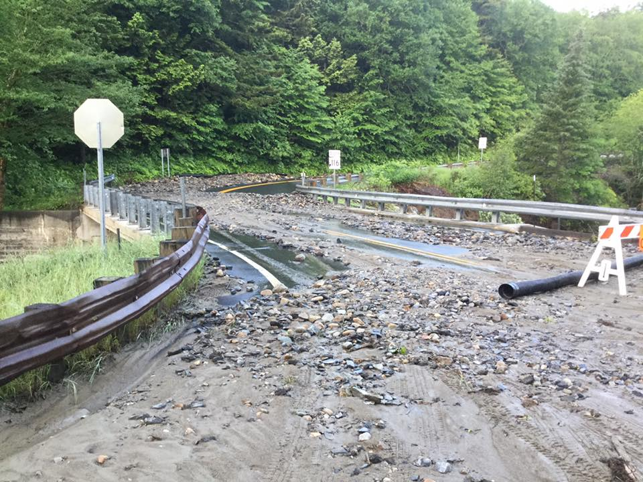
Emergency Work: Category A – Debris Removal
Debris removal activities (clearance, removal, disposal) are eligible if the removal is in the public interest based on whether the work:
Eliminates immediate threats to lives, public health, and safety;
Eliminates immediate threats of significant damage to improved public or private property;
Ensures economic recovery of the affected community to the benefit of the community at large;
Debris includes, but is not limited to, vegetative debris, construction and demolition debris, sand, mud, silt, gravel, rocks, boulders, white goods, and vehicle and vessel wreckage

Slide 19
Alternative Procedure: Debris
Force Account Labor for Eligible Debris Removal
The Applicant may elect to participate in the Alternative Procedures for debris removal and receive reimbursement for straight-time for the Applicant’s budgeted employees that conduct debris removal activities.
The Applicant opts-in by including straight-time in their debris removal (Category A) project claims.
This is a change from previous disasters where only overtime and comp time were eligible for Cat A work.
Notes:
This is new from v4 of the PAPPG

Slide 20
Emergency Work: Category B – Emergency Protective Measures
Actions taken by an Applicant before, during, and after a disaster to eliminate or lessen immediate threats:
to lives, public health, or safety; OR
immediate threats of significant additional damage to improved public or private property in a cost-effective manner.

Slide 21
Category B – Emergency Protective Measures
Examples of EPM to save lives or protect public health or safety (not all inclusive)
Search & Rescue
Transporting and pre-positioning equipment and other resources for response;
Flood fighting;
EOC-related costs;
Emergency access;
Supplies and commodities;
Medical care and transport;
Evacuation and sheltering, including that provided by another State or Tribal government;
Childcare;
Safety inspections;
Animal carcass removal
Demolition of structures
Search and rescue to locate survivors, household pets, and service animals requiring assistance;
Firefighting;
Security, such as barricades, fencing, or law enforcement;
Use or lease of temporary generators for facilities that provide essential community services;
Dissemination of information to the public
Searching to locate and recover human remains;
Storage and interment of unidentified human remains; and
Mass mortuary services.

Slide 22
Category B – Emergency Protective Measures
Examples of EPM to protect improved property (not all inclusive):
Constructing emergency berms or temporary levees to provide protection from floodwaters or landslides;
Emergency repairs necessary to prevent further damage, such as covering a damaged roof to prevent infiltration of rainwater;
Buttressing, shoring, or bracing facilities to stabilize them or prevent collapse;
Emergency slope stabilization;
Mold remediation;
Removal and storage of contents from eligible facilities for the purpose of minimizing additional damage;
Extracting water and clearing mud, silt, or other accumulated debris from eligible facilities if the work is conducted expeditiously for the purpose of addressing an immediate threat
Taking actions to save the lives of animals that are eligible for replacement

Slide 23
Category B – EPM Emergency Access
When incident causes damage or debris blockage to access routes to an essential community service or to community with survivors
Work related to providing access is eligible, such as:
Clearing debris from access facility
Conducting emergency repairs to an access facility (i.e. road or bridge)
Eligible work is limited to necessary for access to remain passable

Slide 24
Category B – EPM Emergency Access
Emergency repairs to privately-owned roads, including those within gated communities, are eligible only when all of the following conditions are met:
There is no other access point;
Repair of the damage economically eliminates the need for temporary housing; and
The Applicant completes all legal processes and obtains rights-of-entry and agreements to indemnify and hold harmless the Federal Government.

Slide 25
Permanent Work: Categories C-G
Eligible permanent work:
Must restore to pre-disaster design (size and capacity) and function in accordance with applicable codes and standards
Must be required as a result of the disaster
Should include cost effective hazard mitigation measures when possible (406 Mitigation)
Notes:
Emergency repair or stabilization to eliminate or lessen an immediate threat is Emergency Work.

Slide 26
Factors That Impact Permanent Work Projects
Elements that may affect the scope of work and funding of a project include:
Special Considerations
EHP
Insurance
Floodplain Management
Hazard Mitigation
Capped Costs
Alternative Project
Improved Projects
Alternate Projects
Pilot Programs (Alternative Procedures)

Slide 27
Environmental and Historic Preservation (EHP)
Several statutes, Executive Orders (EO), and regulations establish requirements to protect the environment and preserve the Nation’s historic and prehistoric resources.
Applicants need to make every effort to afford FEMA the opportunity to perform EHP reviews prior to starting any work that has potential to impact the environment or historic properties, including archaeological resources.
If the Applicant starts this work prior to FEMA’s completion of the EHP review, it jeopardizes PA funding for the entire project
FEMA may be required to consult with Federal, State, Territorial, and Tribal government resource agencies before the Applicant begins work.
USFWS, USACE, SHPO, DES, etc.
The Applicant is responsible for complying with applicable Federal, State, Territorial, or Tribal EHP laws even if FEMA is not providing PA funding for all of the work.

Slide 28
Insurance
Actual or anticipated insurance proceeds will be deducted from the eligible project costs for facilities that are insured.
Applicants that receive PA funding for permanent work to replace, repair, reconstruct, or construct a facility must obtain and maintain insurance to protect the facility against future loss.
If the Applicant does not maintain the required insurance from a previous disaster, then the facility is ineligible for PA funding in a subsequent disaster, regardless of the hazard(s) that caused the damage
For flood damaged facilities located within a Special Flood Hazard Area that are not covered by flood insurance, Federal assistance will be reduced by the maximum flood insurance proceeds that would have been payable had the facility been insured.

Slide 29
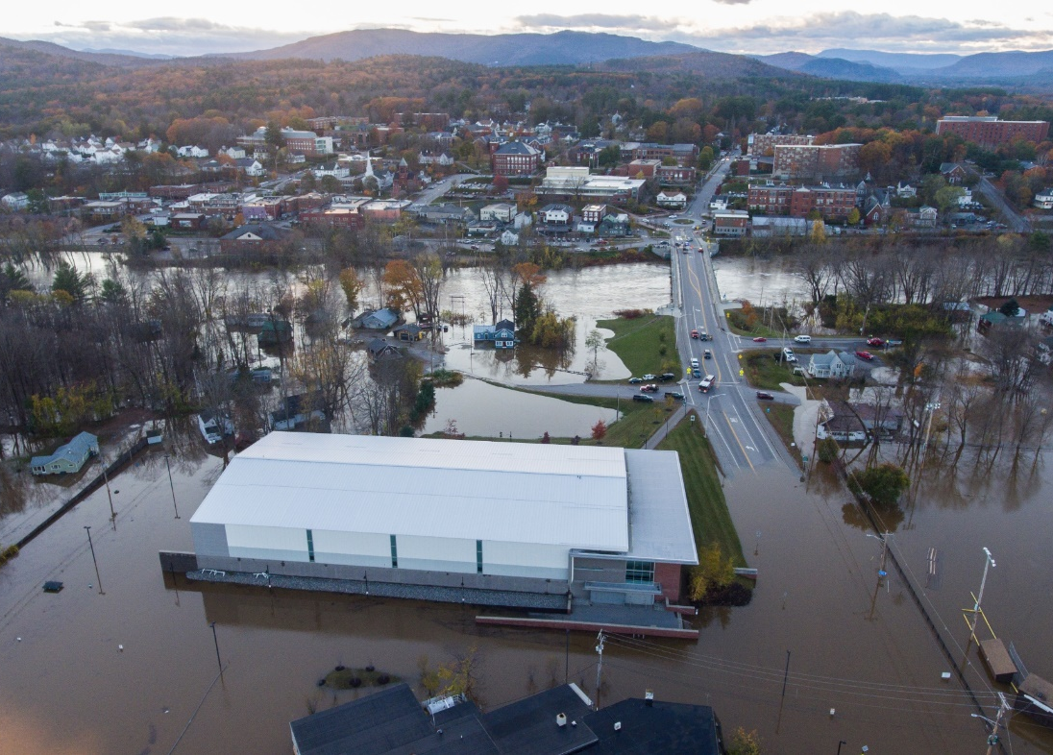
Floodplain Management
Any project within or affecting the floodplain must be reviewed to ensure that it meets the requirements of the Executive Orders on Floodplain Management and the Protection of Wetlands.

Slide 30
Hazard Mitigation
406 (HSEM PA Staff)
PA Mitigation
Mitigation of incident-caused damage
Funding – available for disaster-damaged facilities only
Part of PA project
404 (HSEM SHMO)
HMGP Mitigation
Multi-hazard, statewide mitigation
Funding – available for damaged and non-damaged facilities
Additional 15% of PA obligation per disaster
Competitive Statewide
Notes:
Hazard mitigation is any sustained action taken to reduce or eliminate long-term risk to people and property from natural hazards and their effects.
If FEMA determines mitigation measures to undamaged portions ineligible as 406 hazard mitigation, the Applicant may request HMGP (Section 404) funding from the State or Territory to provide protection to undamaged portions, while utilizing PA Program (Section 406) mitigation funds to provide protection to damaged portions.

Slide 31
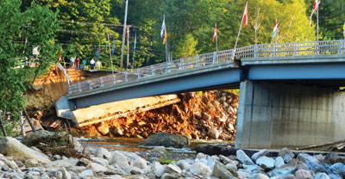
PA Hazard Mitigation (406)
Cost effective measures that reduce or eliminate the potential for similar damages to a facility from a future event of the same type.
Loon Mountain Bridge Replacement –Irene 2011
Notes:
Section 406 hazard mitigation opportunities usually present themselves during facility repair. However, in cases where the Applicant must repair a facility in an expedited manner, it may miss an opportunity to implement mitigation measures during repair. If the Applicant implements mitigation measures after the PA-funded repair is complete, the mitigation work may be eligible; however, FEMA will not provide PA funding for any duplicative work as a result of the subsequent mitigation.
In some instances, the Applicant may implement mitigation measures after the incident occurs but before the incident is declared or before FEMA has the opportunity to evaluate the measure for eligibility. In these cases, the mitigation work may still be eligible if it is cost-effective and FEMA confirms compliance with applicable EHP laws, regulations, and EOs.
If FEMA approves mitigation funding and the Applicant does not complete the mitigation work, FEMA will deobligate the mitigation funds.
The cost for the mitigation measure does not exceed 15 percent of the total eligible repaircost (prior to any insurance reductions) of the facility or facilities for which themitigation measure applies;
•The mitigation measure is specifically listed in Appendix J: Cost-Effective PublicAssistance Hazard Mitigation Measures, AND the cost of the mitigation measure doesnot exceed 100 percent of the eligible repair cost (prior to any insurance reductions) ofthe facility or facilities for which the mitigation measure applies; and
•The Recipient or Applicant demonstrates through an acceptable benefit-cost analysis(BCA) methodology that the measure is cost-effective. FEMA’s BCA software297provides appropriate BCA methodologies.

Slide 32
PA Hazard Mitigation (406)
Must be cost-effective via one of the following methods:
15% Rule
Cost for the mitigation measure does not exceed 15 percent of the total eligible repair cost (prior to any insurance reductions) of the facility or facilities for which the mitigation measure applies
100% Rule under PAPPG Appendix J
The proposed mitigation measure is specifically listed in Appendix J: Cost-Effective Public Assistance Hazard Mitigation Measures, AND the cost of the mitigation measure does not exceed 100 percent of the eligible repair cost (prior to any insurance reductions) of the facility or facilities for which the mitigation measure applies
Benefit Cost Analysis (BCA)
Demonstrates through an acceptable benefit-cost analysis (BCA) methodology that the measure is cost-effective.
Notes:
Section 406 hazard mitigation opportunities usually present themselves during facility repair. However, in cases where the Applicant must repair a facility in an expedited manner, it may miss an opportunity to implement mitigation measures during repair. If the Applicant implements mitigation measures after the PA-funded repair is complete, the mitigation work may be eligible; however, FEMA will not provide PA funding for any duplicative work as a result of the subsequent mitigation.
In some instances, the Applicant may implement mitigation measures after the incident occurs but before the incident is declared or before FEMA has the opportunity to evaluate the measure for eligibility. In these cases, the mitigation work may still be eligible if it is cost-effective and FEMA confirms compliance with applicable EHP laws, regulations, and EOs.
If FEMA approves mitigation funding and the Applicant does not complete the mitigation work, FEMA will deobligate the mitigation funds.
The cost for the mitigation measure does not exceed 15 percent of the total eligible repaircost (prior to any insurance reductions) of the facility or facilities for which themitigation measure applies;
•The mitigation measure is specifically listed in Appendix J: Cost-Effective PublicAssistance Hazard Mitigation Measures, AND the cost of the mitigation measure doesnot exceed 100 percent of the eligible repair cost (prior to any insurance reductions) ofthe facility or facilities for which the mitigation measure applies; and
•The Recipient or Applicant demonstrates through an acceptable benefit-cost analysis(BCA) methodology that the measure is cost-effective. FEMA’s BCA software297provides appropriate BCA methodologies.

Slide 33
Benefit Cost Analysis
A BCA is based on a comparison of the total estimated cost for the PA mitigation measure to the total value of expected benefits to society.
FEMA’s BCA methodology considers common project benefits, which include reductions in the magnitude or frequency of:
Damage to the facility and its contents;
The need for emergency protective measures;
The need for temporary facilities;
Loss of function;
Casualties (typically included only for earthquake, tornado, and wildfire mitigation); and
Previous impacts regardless of whether the impacts occurred in Federal declarations (only if documented).

Slide 34
Hazard Mitigation Grant Program (HMGP) (404)
This funding is SEPARATE from the projects that will be submitted under the FEMA PA Program.
The State will be receiving an additional 15% for HMGP
(funding is competitive statewide)
Request for Letters of Intent (LOIs) were sent out on October 5, 2021
Applicants must have a Formally Approved Local Hazard Mitigation Plan at the time of obligation of grant funds (projects only) and projects must be consistent with the plan’s goals and objectives.
LOIs will be accepted until December 7, 2021
HMGP application packages will follow for all eligible projects
Having an eligible project does not guarantee funding. Once we receive the full application package an inter-agency review will be conducted to prioritize the projects (communities within the declared counties will maintain precedence).
Eligible activities can be located within the HMGP Brochure

Slide 35
Contact Info: HMGP Staff
Brian Eaton
State Hazard Mitigation Officer
brian.e.eaton@dos.nh.gov
o. 603-227-8724 | c. 603-724-1064

Slide 36
Capped Projects
FEMA provides three options that provide flexibility for the Applicant to use PA funding differently than restoring the pre-disaster design and function of the facility.
For these options, FEMA caps the amount of PA funding based on the estimated amount to restore the damaged facility to its pre-disaster design and function
Alternative Procedures Project
Improved Project
Alternate Project

Slide 37
Alternative Procedure Project under Section 428
Permanent Work, Large Projects Only
Applicant may use funds across all Permanent Work Alternative Procedures Projects with no requirement to rebuild communities back to what existed prior to the disaster
Requirement: Must accept a subaward based on a capped funding amount (fixed-cost estimate). Any costs above that amount are at the expense of the Subrecipient.
Options:
Consolidation of Fixed Cost Estimate Subawards
Elimination of the Reduction in Eligible Costs for Alternate Projects
Use of Excess Funds
Special Consideration Reviews
Notes:
Use of excess funds When the actual cost of the work under a subaward is less than the fixed estimate, the subrecipient may use the excess funds for PA Program-related purposes.

Slide 38
Alternative Project Example
A road crosses a water course and its adjacent floodplain using five culverts.
During the incident, floodwaters overtop the road and damage the crossings, either by washing out the culverts or by damaging the roadway and headwalls.
FEMA prepares and approves a subaward with five site sheets to repair or replace each culvert crossing, including hazard mitigation measures to increase the size of the culverts.
Subsequently, the Applicant requests that the aggregate funding for the five crossings be used to replace the current configuration with one bridge.

Slide 39
Improved Projects
Applicant may wish to make improvements to a damaged facility that are not required by eligible codes or standards.
A project that restores the pre-disaster function of a facility and incorporates improvements or changes to the pre-disaster design is an Improved Project.
Must have the same function and at least the same capacity that existed immediately prior to the disaster.
Examples of Improved Projects:
Laying asphalt on a gravel road
Replacing a fire station that originally had two bays with one that has three bays
Incorporating requirements dictated by a code or standard that does not meet PA eligibility criteria
Relocating a facility when the relocation is not required by FEMA
Notes:
Improved Project: When restoring a damaged facility, the Applicant may decide to make improvements to the facility. A project that incorporates such improvements is an Improved Project.
eligible codes or standards.

Slide 40
Improved Projects
The improvements must be approved by FEMA and the Recipient prior to construction.
The Subrecipient is responsible for the cost of the improvements above the FEMA estimate;
Federal funding is limited to the Federal cost share of the approved estimated cost to restore the facility to its pre-disaster design and function or improved project costs, whichever is less.
Notes:
Improved Project: A project that restores the pre-disaster function, and at least the same capacity, of the damaged facility and incorporates improvements
or changes to its pre-disaster design not required by eligible codes or standards.

Slide 41
Alternate Projects
Funds are used toward a project that does not restore the pre-disaster function of the damaged facility.
May be used when Applicant determines that the public welfare would not be best served by restoring a damaged facility or its function.
Must be a permanent project that benefits the general public, serving the same general area that was being served by the original facility
Must be approved by FEMA prior to construction
May require an environmental assessment
Federal funding is limited to 90% of the Federal share of the original project estimate or actual alternate project cost (whichever is less)

Slide 42
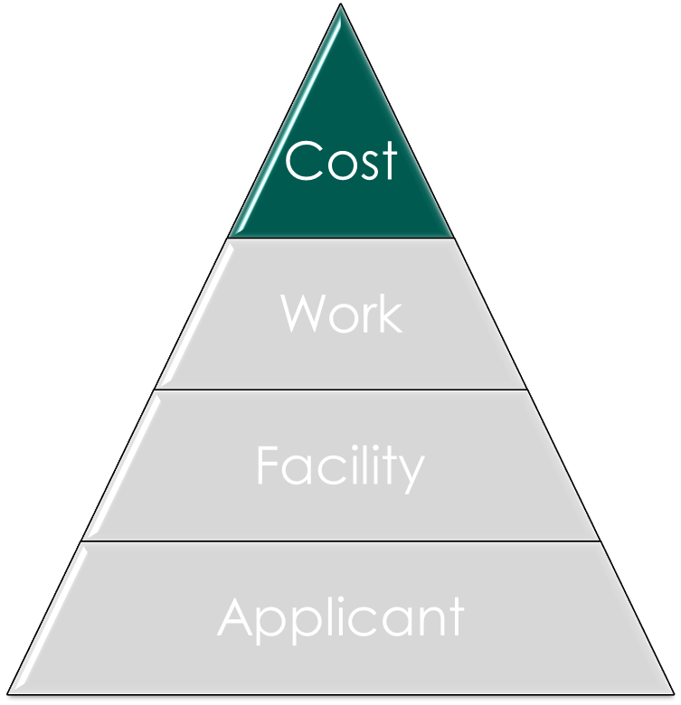
Cost Eligibility
To be eligible for reimbursement, costs must be:
Directly tied to the performance of eligible work,
Adequately documented,
Reduced by all applicable credits, such as insurance proceeds and salvage values,
Authorized and not prohibited under Federal, State, Territorial, or local government laws or regulations
Consistent with the Applicant’s internal policies, regulations, AND
Necessary and reasonable to accomplish the work properly and effectively.

Slide 43
Reasonable Costs
A cost is reasonable if, in its nature and amount, it does not exceed that which would be incurred by a prudent person under the circumstances prevailing at the time the Applicant makes the decision to incur the cost
FEMA takes in to consideration if the cost is comparable to the current market price for similar goods or services in the same geographical area. Based on:
Historical documentation (previous contracts, invoices, or other documentation).
Average costs in the area.
Published unit costs from national cost estimating databases.

Slide 44
Procurement Standards
ALL Applicants must comply with Federal procurement standards and 2 CFR §200
State Applicants must follow the same policies and procedures as would for procurement with non-Federal funds, with the addition of some federal rules
Non-State Applicants (Local governments and PNPs) must use their own documented procurement procedures that reflect applicable State, and local government laws and regulations; and 2 CFR §200
Notes:
A cost is reasonable if, in its nature and amount, it does not exceed that which would be incurred by a prudent person under the circumstances prevailing at the time the Applicant makes the decision to incur the cost.

Slide 45
Procurement & Contracting Requirements – Locals/PNPs
Local governments, including PNPs must comply with:
Their own documented procurement procedures;
Applicable SLTT government laws and regulations; and
Applicable Federal laws and regulations.
If a Federal requirement is different than the SLTT requirement, or the Applicant’s own requirements, it must use the more restrictive requirement.
Federal procurement requirements include, but are not limited to:
Providing full and open competition
Use of small and minority businesses, women's business enterprises, and labor surplus area firms, when possible.
Performing a cost or price analysis in connection with every procurement action above the simplified acquisition threshold
Evaluating and documenting the contractor’s integrity, compliance with public policy, record of past performance, and financial and technical resources.
Ensuring that the contractor was not suspended or debarred
Prohibiting the use of statutorily or administratively imposed SLTT geographic preferences in evaluating bids or proposals except where expressly encouraged by applicable Federal law.
Excluding contractors that develop or draft specifications, requirements, statements of work, or invitations for bids or requests for proposals from competing for such procurements to ensure objective contractor performance and eliminate unfair competitive advantage.
Maintaining records to detail the history of the procurement.

Slide 46
Procurement Methods
Local governments and PNPs must use one of the following procurement methods:
Micro-purchase;
purchase of supplies or services where the total cost does not exceed the micro-purchase threshold set by the Federal Acquisition Regulation at 48 C.F.R. Subpart 2.1
Small purchase procedure;
relatively simple and informal procurement method for securing services, supplies, or other property that do not cost more than the simplified acquisition threshold set by the Federal Acquisition Regulation at 48 C.F.R. Subpart 2.1.
Sealed bid (formal advertising);
publicly solicited bid awarded via a firm fixed price contract to the lowest responsive and responsible bidder.
Competitive proposal; or
normally conducted with more than one source submitting an offer and generally used when conditions are not appropriate for the use of sealed bids.
Noncompetitive proposal (sole-sourcing).
solicitation of a proposal from only one source.

Slide 47
Contracts
FEMA reimburses costs incurred using three types of contract payment obligations:
Fixed-price
Cost-reimbursement
To a limited extent, time and materials (T&M).
Applicant must include required provisions in all contracts awarded and maintain oversight to ensure contractors perform according to the conditions and specifications of the contract and any purchase orders
FEMA does not reimburse costs incurred under a cost plus percentage of cost contract or a contract with a percentage of construction cost method.

Slide 48
Required Contract Clauses
Applicants must include required provisions detailed in 2 C.F.R. § 200.326 in all contracts awarded.
Required contract provisions include:
Remedies Clause;
Termination for Cause;
Termination for Convenience;
Equal Employment Opportunity;
Contract Work Hours and Safety Standards Act;
Homeland Security Acquisition Regulation Class Deviation 15-01 clauses;
Clean Air Act;
Federal Water Pollution Control Act;
Debarment and Suspension;
Byrd Anti-Lobbying Amendment Clause;
Byrd Anti-Lobbying Amendment Certification; and
Procurement of Recovered Materials.

Slide 49
Donated Resources
Applicants may use the value of donated resources used for eligible work to offset the non-Federal share if all of the following conditions are met:
The donated resource is from a third party;
The donated resource is necessary and reasonable;
The applicant uses the resource to perform eligible work; AND
The applicant or volunteer tracks the resources and work performed, including description, locations, and hours
Offset amounts can include unpaid volunteer labor, donated equipment, and donated materials.
Notes:
FEMA does not provide PA funding for donated resources – however the applicant can use the value of the donated resources to offset the cost share of emergency work.

Slide 50
Management Costs (MC)
Administrative costs reimbursed as Management Costs are for costs for activities related to the receipt and administration of PA funding, not on work/activities completed as part of the project.
Costs incurred to manage the project/complete the work = project costs (Categories A-G)
Cost incurred to manage the PA grant and seek reimbursement from FEMA = Management Costs (MC) (Category Z)

Slide 51
Management Costs (MC)
Reimbursement (per each applicant)
up to 5% of the total project amount obligated for the disaster
for actual costs incurred only (no excess funds)
100% federal share (no cost share for the Subrecipient)
Documentation required for all expenses
Awarded as a separate Category Z project
Eligible expenses include:
Indirect costs
Direct Administrative Costs
Other administrative expenses associated with the disaster

Slide 52
MC Eligible Expenses
Labor, Equipment, and Supplies associated with the following activities: (not an all inclusive list)
Applicant Briefings
Meetings regarding the PA Program or overall PA damage claim
Preparing correspondence
Collecting, copying, filing, or submitting documents to support a claim
Developing the detailed damage description
Organizing PA damages into logical groups
Preparing and Reviewing PWs
Preparing Small and Large Projects
Requesting disbursement of PA funds
Travel expenses
Training
Track ALL time and expenses spent on the management of the grant

Slide 54
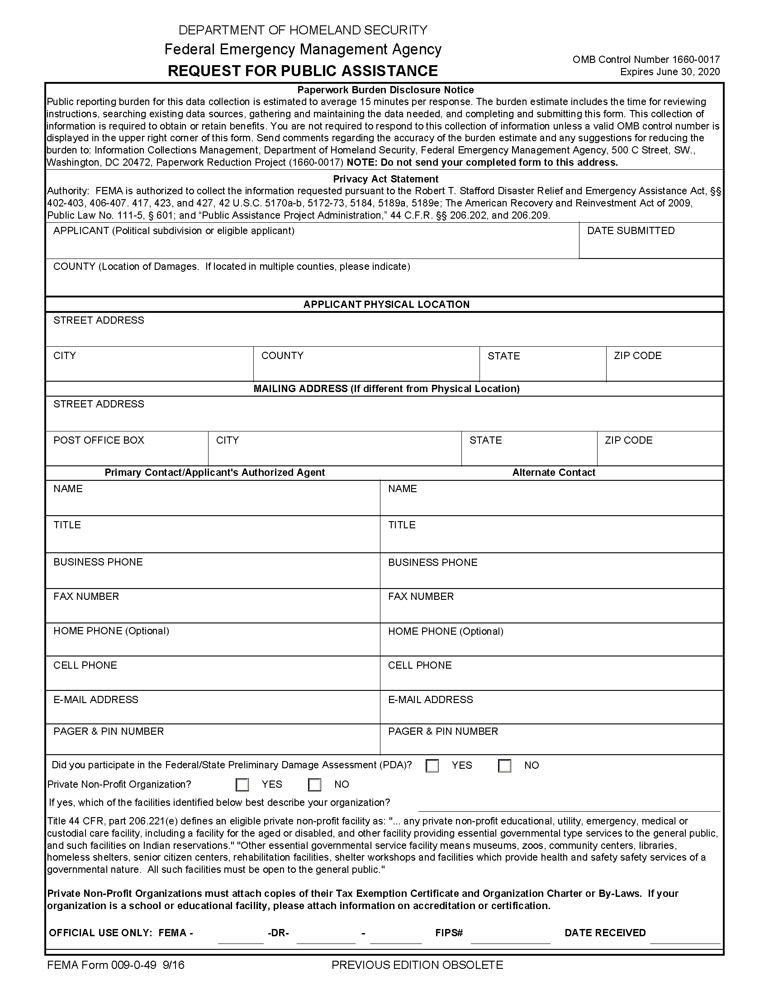
Request for Public Assistance
The Request for Public Assistance (RPA) must be submitted to HSEM by:
DR 4622 - 10/26/2021
DR 4624 - 11/01/2021
Each entity that would like to participate in the PA Program must submit this form
You may submit in Grants Portal (if you already have an account), or fill out a hard copy
Notes:
HSEM needs a couple days to review and approve before due to FEMA

Slide 56
Exploratory Call (EC)
Occurs within 7 days of PDMG assignment
Conference call with FEMA and HSEM
Introduce PDMG to Applicant
Discuss damages at high level
Schedule date/time for Recovery Scoping Meeting (RSM)
Notes:
PDMG assignment may take some time.

Slide 58
Recovery Scoping Meeting (RSM)
Scheduled within 21 days of PDMG assignment
Staff with knowledge of the incident-related damage, emergency activities performed, and related costs attend the meeting (e.g., public works official, finance staff, risk manager).
Review and refine the list of impacts and discuss
PA delivery process;
Details of the Applicant’s impacts from the incident;
Hazard mitigation opportunities;
Eligibility criteria for facilities, work and costs;
Logical grouping of damage;
Procurement requirements;
Insurance reductions and requirements;
EHP compliance requirements;
Documentation requirements;
Interagency Recovery Coordination;
Deadlines; and
Appeal process.
Notes:
While the Applicant Briefing provides high-level information for all potential Applicants, the Recovery Scoping Meeting addresses the specific needs of each eligible Applicant.

Slide 60
Damage Inventory
Must be submitted within 60 days of RSM
Submitted through Grants Portal
Excel spreadsheet to log all damages that includes:
Category of Work
Facility/Damage Name
Address, including Lat/Long
Description
Approximate Cost
% Work Complete
Labor Type
Priority
Identify any and all possible damages in this time period! Eligibility will be determined later.

Slide 61
Project Formulation
Site Inspections may take place before projects are formulated
Formulate incident-related damage and work into projects based on logical groupings of the damage and work
Who, What, Where, Why and How Much of damages

Slide 62
Project Formulation
Identify & Report Damages
must be completed within 60 days of RSM
Develop Scope of Work (SOW)
Develop Project Cost
Provide Project Documentation

Slide 63
Example: Projects in Grants Portal

Slide 64
Minimum Project Thresholds
DR 4622 - FFY 2021: $3,320
DR 4624 – FFY 2022: $3,500
If a Project totals less than the minimum threshold after the Applicant has accounted for all project costs, the project is not eligible.

Slide 65
Small v. Large Projects
Small project maximum threshold
DR 4622 - FFY 2021: $132,800
DR 4624 - FFY 2022: $139,800
Projects with a total cost of this amount or greater are considered to be large projects.
Adjusted each Federal Fiscal Year (FFY)
Based on the final approved amount of eligible costs

Slide 66
Small v. Large Projects
Small Projects
Payment is made at the time of project approval based on an estimate, or actual costs if they are known.
FEMA does not reconcile costs at project completion. If estimate is greater than the actual cost, Subrecipient may retain leftover funding. Cost overruns can be addressed via a project amendment.
Large Projects
Award funding based on estimated costs and project funding is later reconciled based on documented actual costs.
Project payments are made to the Applicant (through the Recipient) as actual costs are documented. Reimbursement requests showing proof of payment are required to receive funds.
Notes:
FEMA administers small and large projects differently.

Slide 67
Project Completion Deadlines
Time limits for project completion begin on the disaster declaration date.
Emergency work must be completed within 6 months
DR 4622 - March 30, 2022
DR 4624 – April 4, 2022
Permanent work must be completed within 18 months
DR 4622 - March 30, 2023
DR 4624 – April 4, 2023
Extensions may be requested from the Recipient (State) for an additional 6 months for emergency work and up to 30 months for permanent work. FEMA must approve extensions outside of these limits.

Slide 68
Documentation
Must maintain all source documentation supporting project costs.
The Recipient and the Applicant must keep all financial and program documentation for three years after the date the entire disaster is closed out with FEMA. HSEM will send out record retention dates as disasters are closed out.
Records are subject to audit by State auditors, FEMA, the U.S. Department of Homeland Security Office of Inspector General, and the U.S. Government Accountability Office.
Notes:
Close out date – Irene example

Slide 69
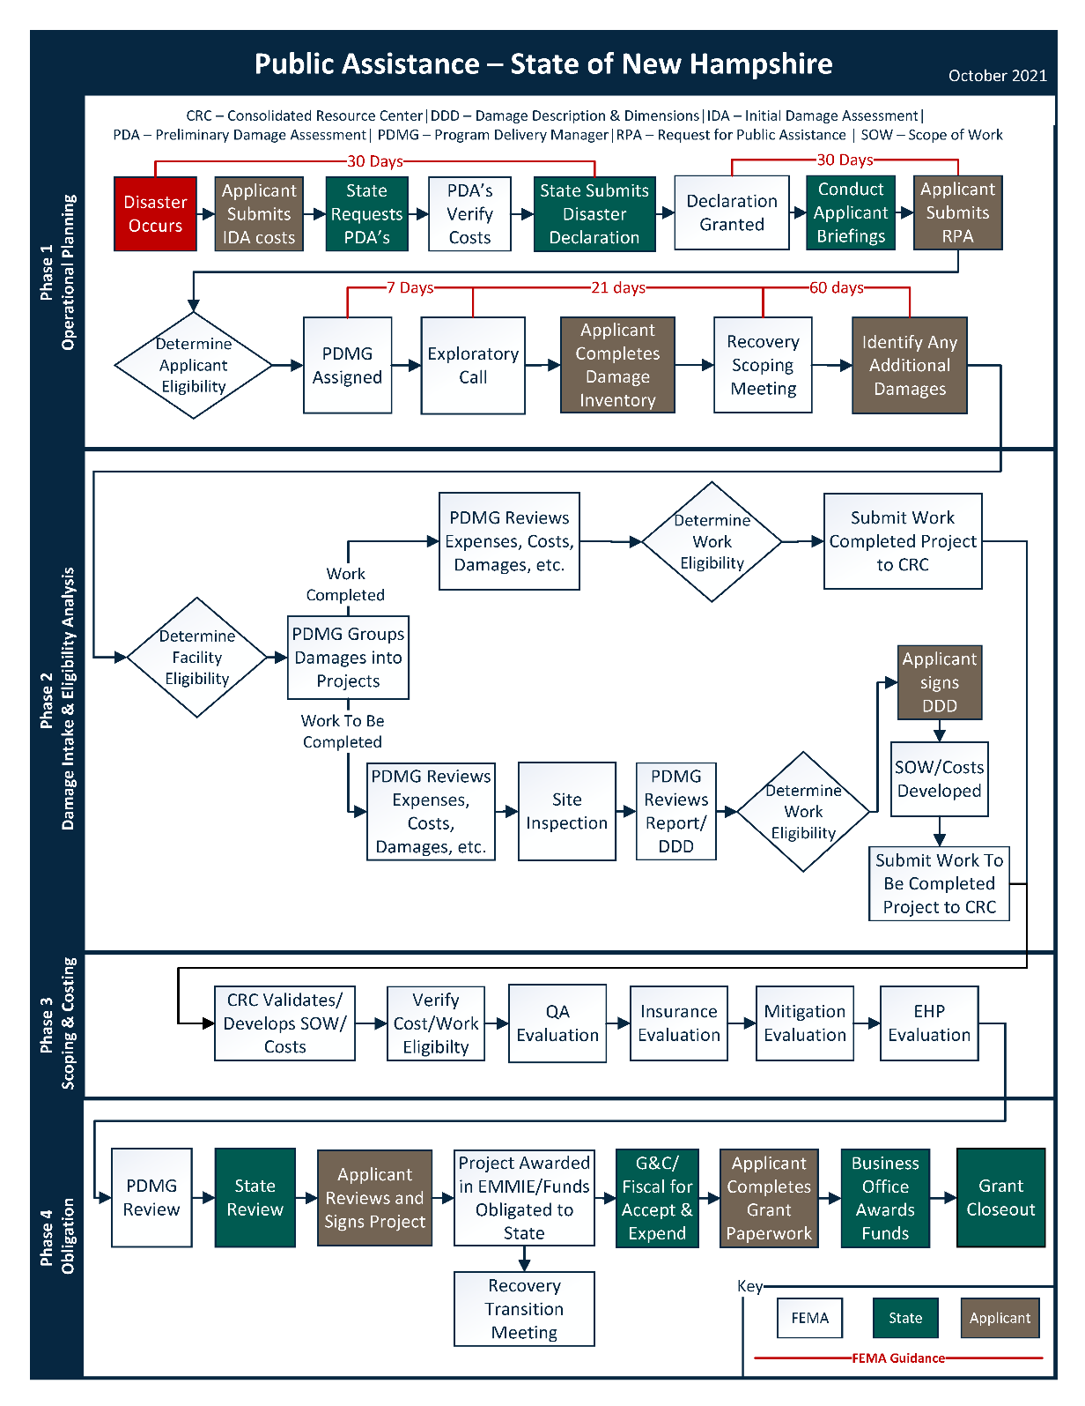

Slide 70
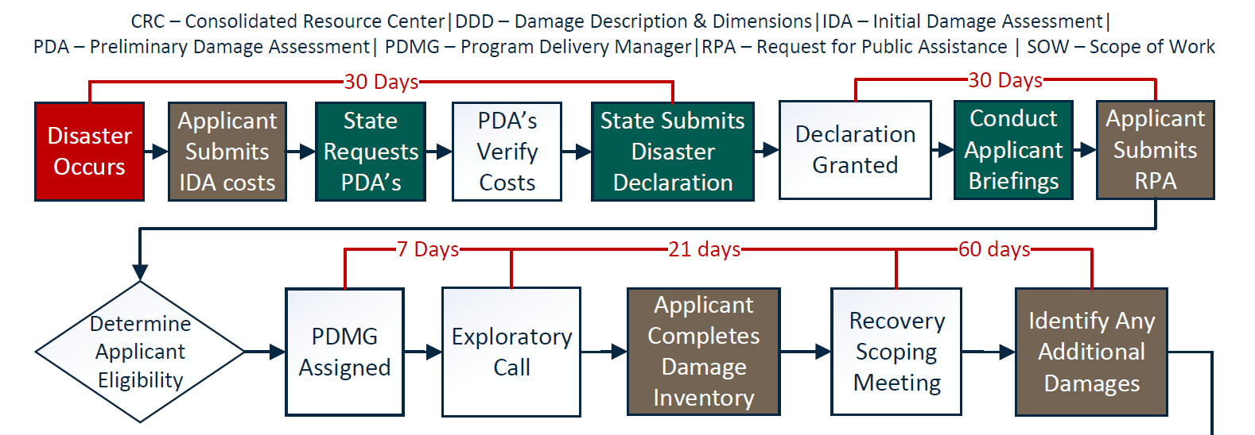
Phase 1: Operational Planning

Slide 71
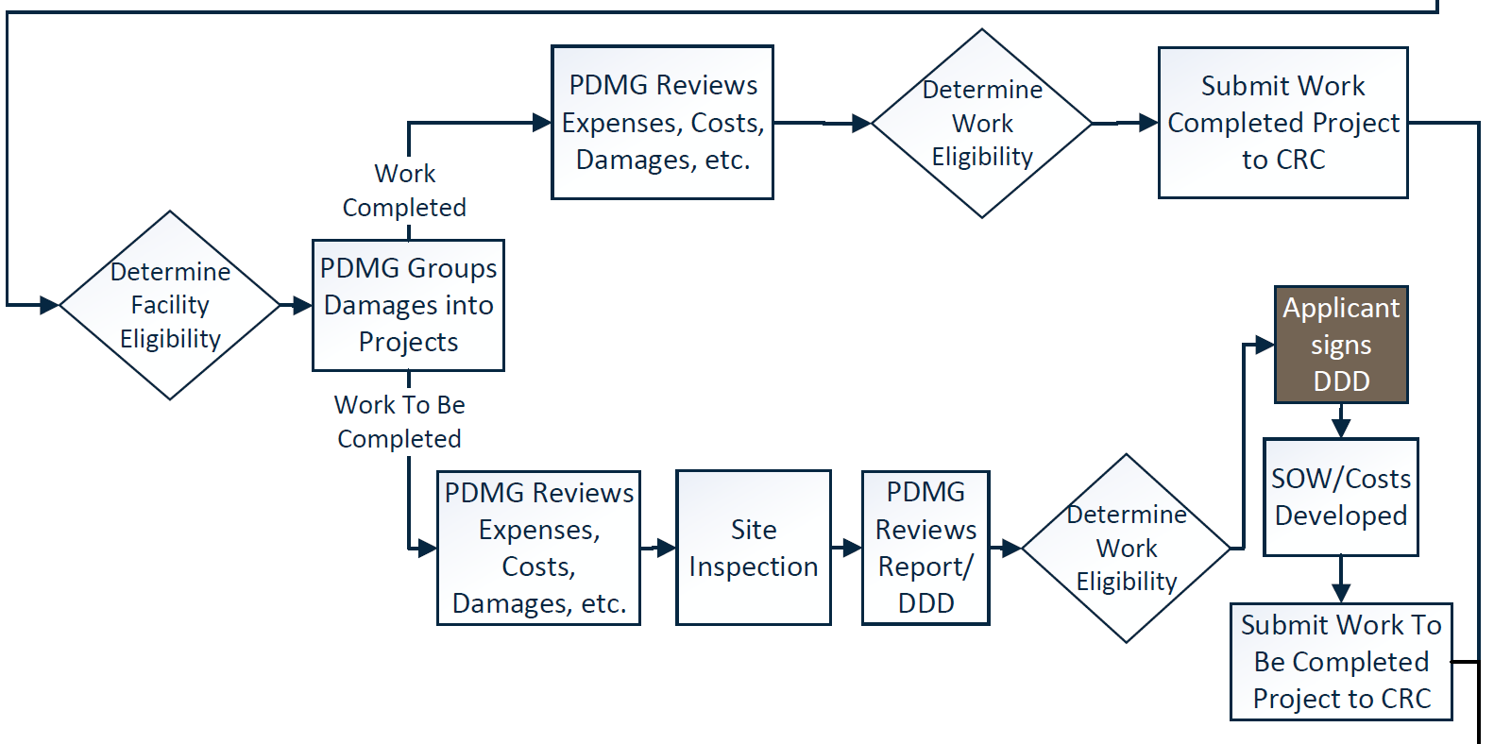
Phase 2: Damage Intake & Eligibility Analysis

Slide 72
Phase 3: Scoping & Costing

Slide 73
Phase 4: Obligation

Slide 74
Expedited Funding
FEMA may provide expedited funding for PA emergency work activities that meet or exceed the large project threshold.
FEMA will use estimated costs instead of actual costs or site inspections
Funding:
Limited to defined operational periods (30, 60, or 90 days)
Awarded at 50% of the estimated cost to complete work
Federally funded at the disaster cost share (75% Federal/25% Non-Federal for DR 4622 & DR 4624)
Notes:
Requests for Expedited Projects must be submitted to FEMA within 60 days of the Applicant’s Recovery Scoping Meeting. To support its request, the Applicant must provide enough information for FEMA to validate that the work and costs are eligible. FEMA will work to obligate funding within 90 days of receipt of the request.

Slide 75
PA Grants Portal:
Developed to assist Applicants and Recipients
Facilitates full project visibility/transparency
Enhances coordination and communication
User friendly - streamlines work and workflow
Significantly improves document collection and retention
Receive emails from support@pagrants.fema.gov

Slide 76
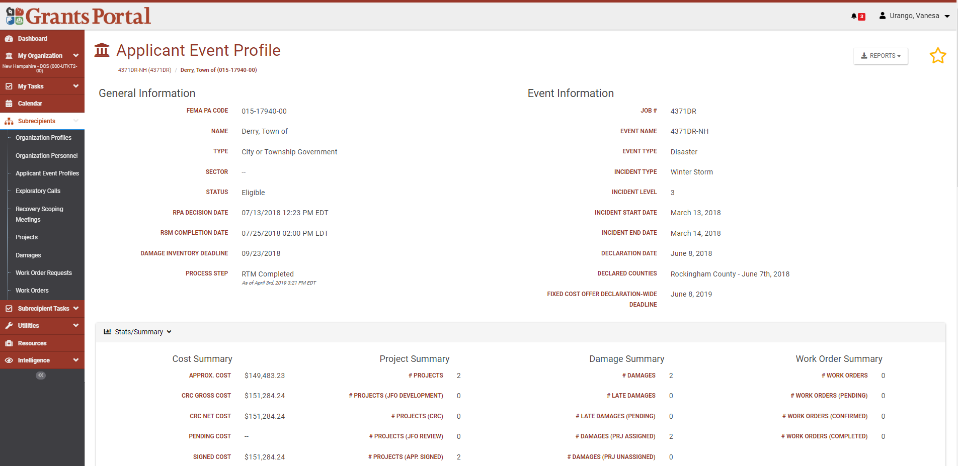

Slide 77
Timelines & Deadlines
Applying for a Public Assistance Award
Applicants must submit a Request for Public Assistance (RPA) to FEMA through the Recipient within 30 days of the designation of the declared disaster area. All RPAs to HSEM by October 26th for DR 4622 and November 1st for DR 4624.
Identify and Report Damage
The Applicant is required to identify and report all of its disaster-related damage, emergency work activities, and debris quantities to FEMA within 60 days of the Recovery Scoping Meeting (RSM).
Appeals
Any determination of ineligibility related to Federal assistance may be appealed. The appeal must be submitted to the Recipient within 60 days of receipt of notice of the action which is being appealed. No extensions permitted.

Slide 78
Contact Info: HSEM PA Staff
Vanesa Urango
Assistant Chief of Recovery
vanesa.e.urango@dos.nh.gov
o. 603-223-3602 | c. 603-931-0309
Jamie Easterbrooks
Public Assistance Coordinator for DR 4622 & 4624
jamie.r.easterbrooks@dos.nh.gov
o. 603-223-8072 | c. 603-717-1153
Submit RPA via Grants Portal or nhpa@dos.nh.gov

