Slide 1


Slide 2


Slide 3
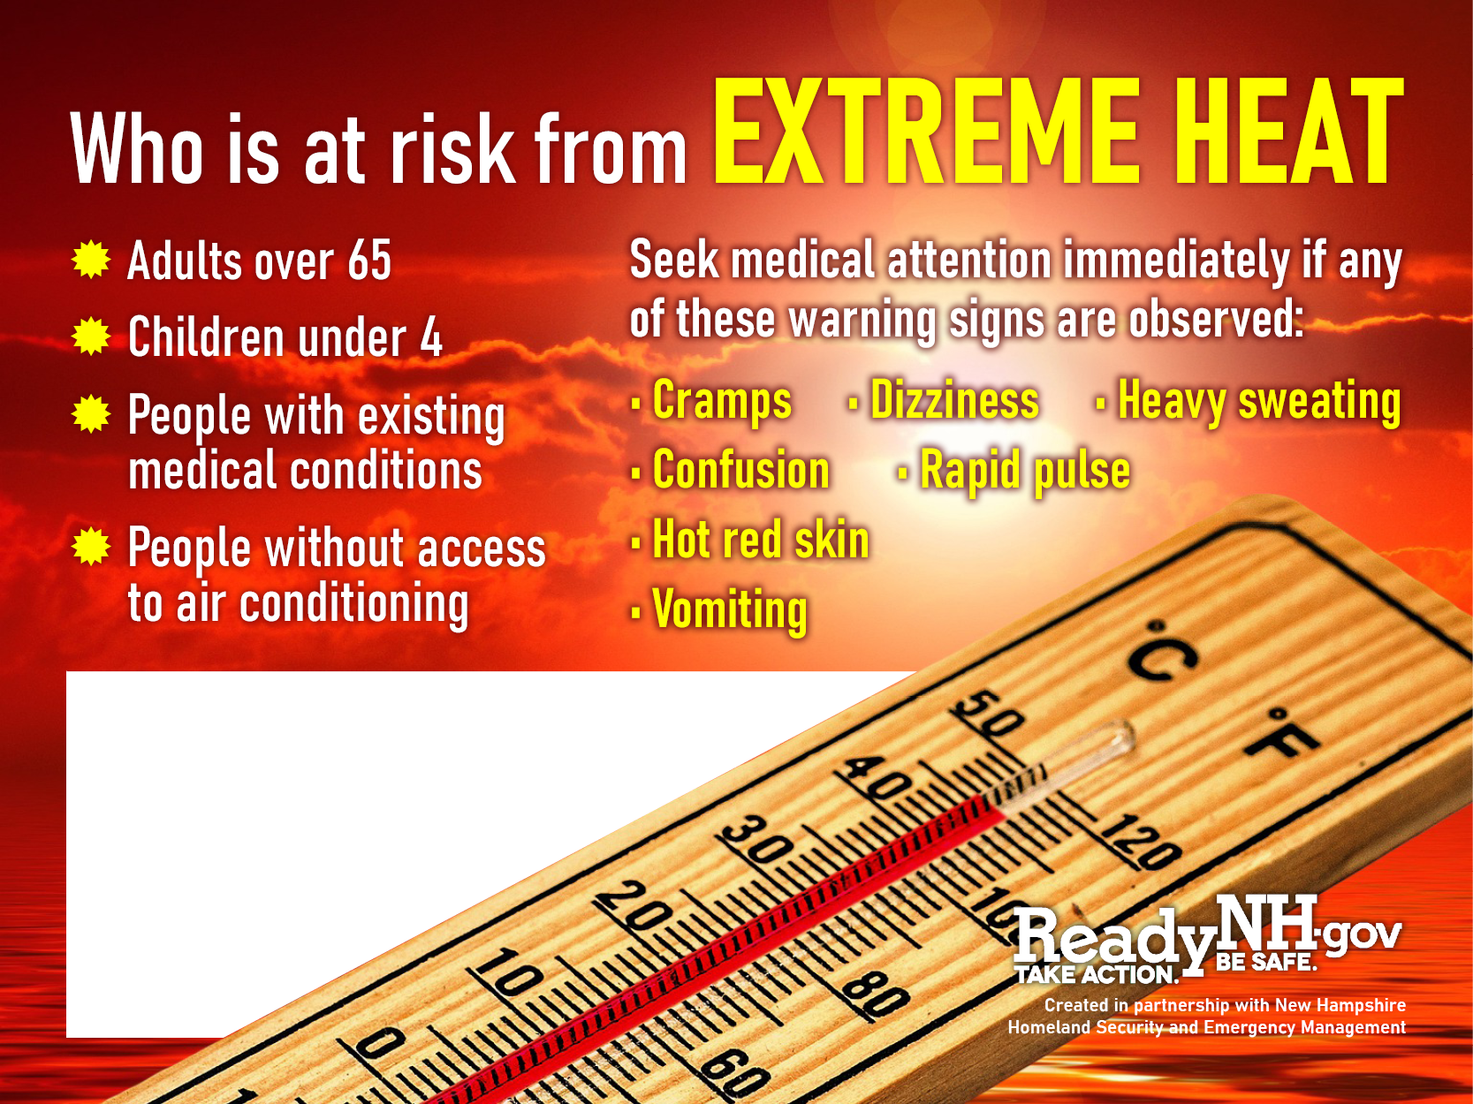

Slide 4
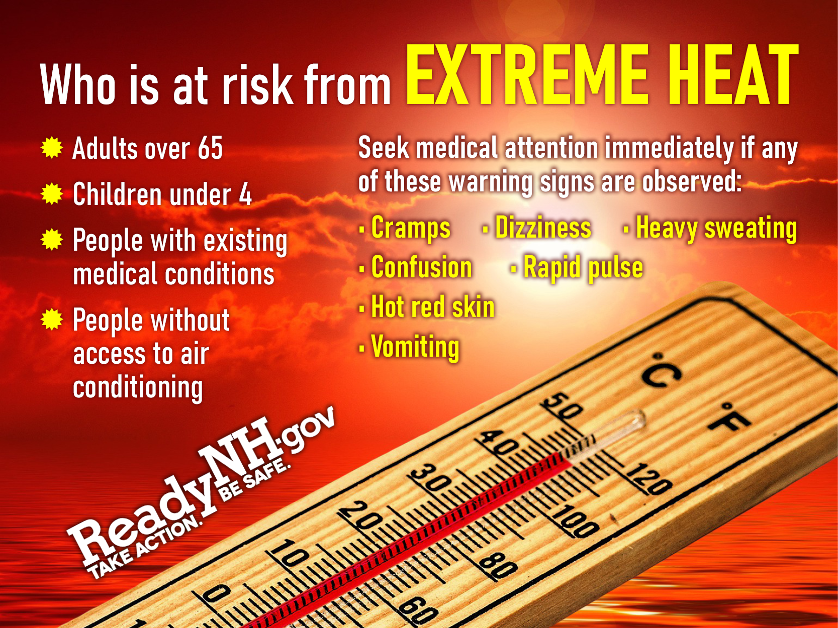

Slide 5


Slide 6


Slide 7

<<Add details such as when, where and contact information here>>

Slide 8

<<Add details such as when, where and contact information here>>

Slide 9

<<Add details such as when, where and contact information here>>

